Slide 1
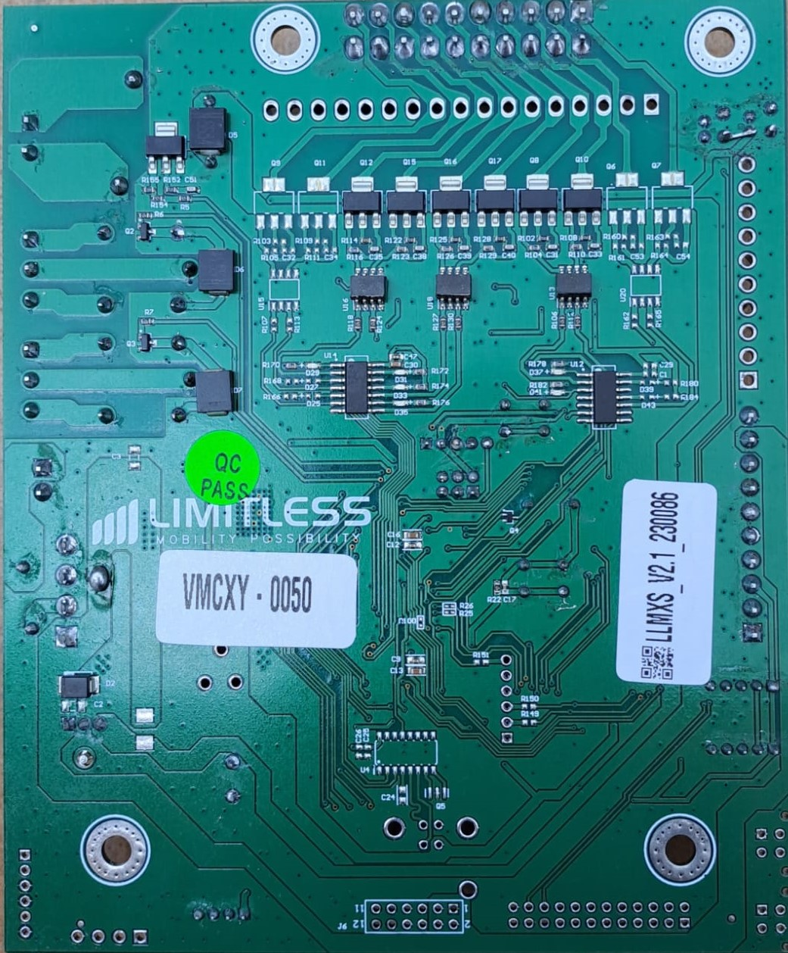
+ve side driver
OPTO-Isolator
TTL To CMOS
J6

Slide 3
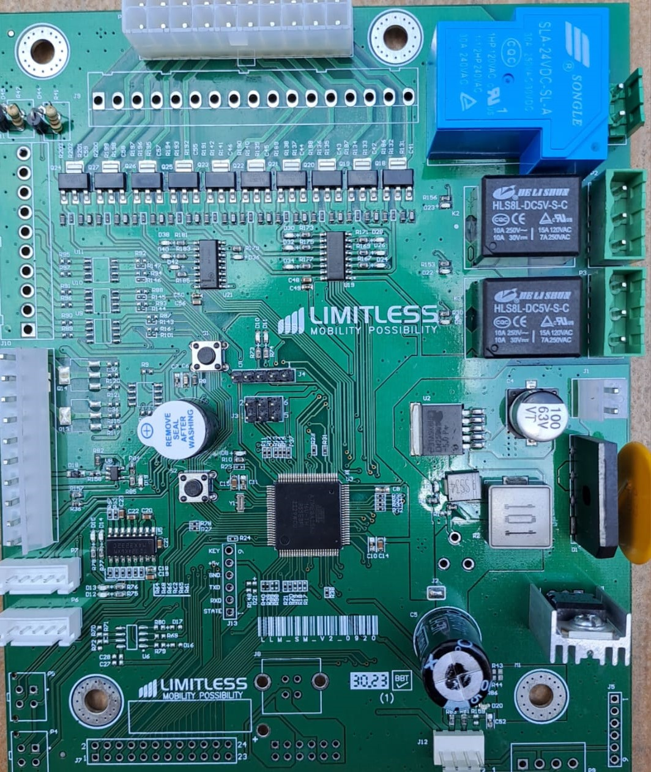
Power supply
-ve supply
Reset switch
Coolant and Fan
Programming Port
Sega
Serial monitor
ATmega2549
Master
Sensor
USB Type B Connector
Sensor

Slide 4
P8
Relay for compressor
J9
-ve side(column drive)
P1
J11
Reset switch
Driver for Compressor
Programming debug Port
Relay for Coolant
J10
J1
Mode switch
Serial debug monitor
Serial port for communication with master
Sensor for food packet delivery
P5
P4
J7
USB Type B Connector
Sensor for food packet delivery

